Slide 1
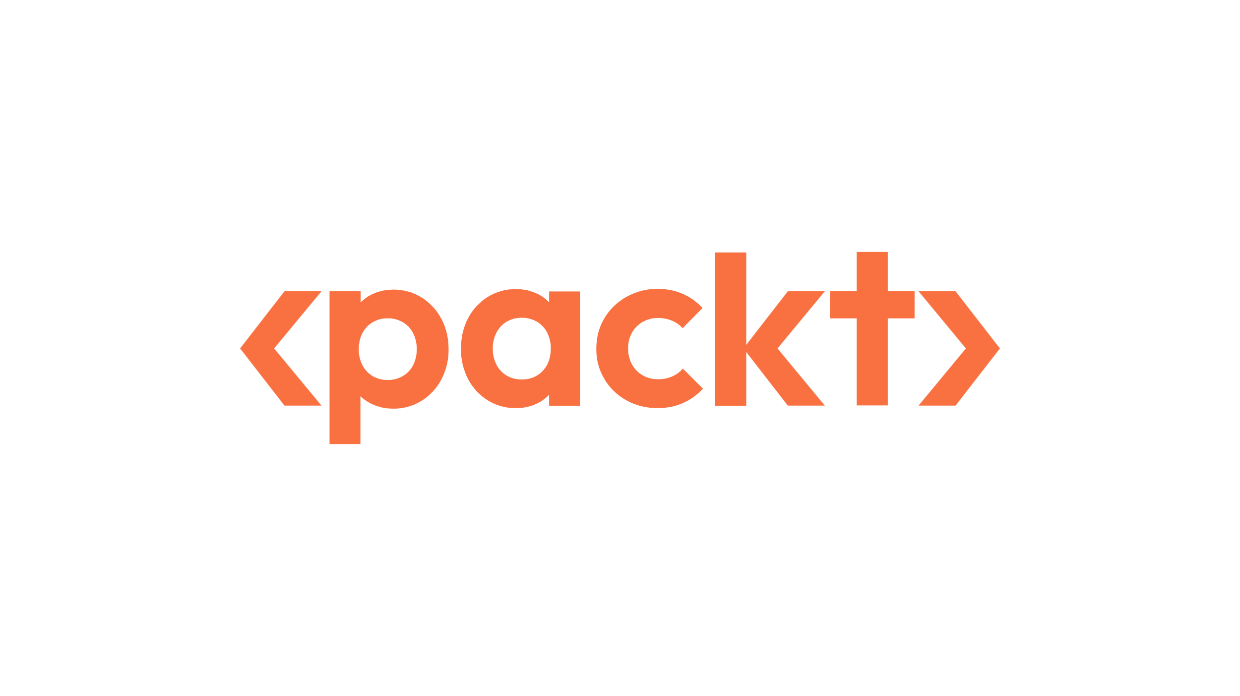
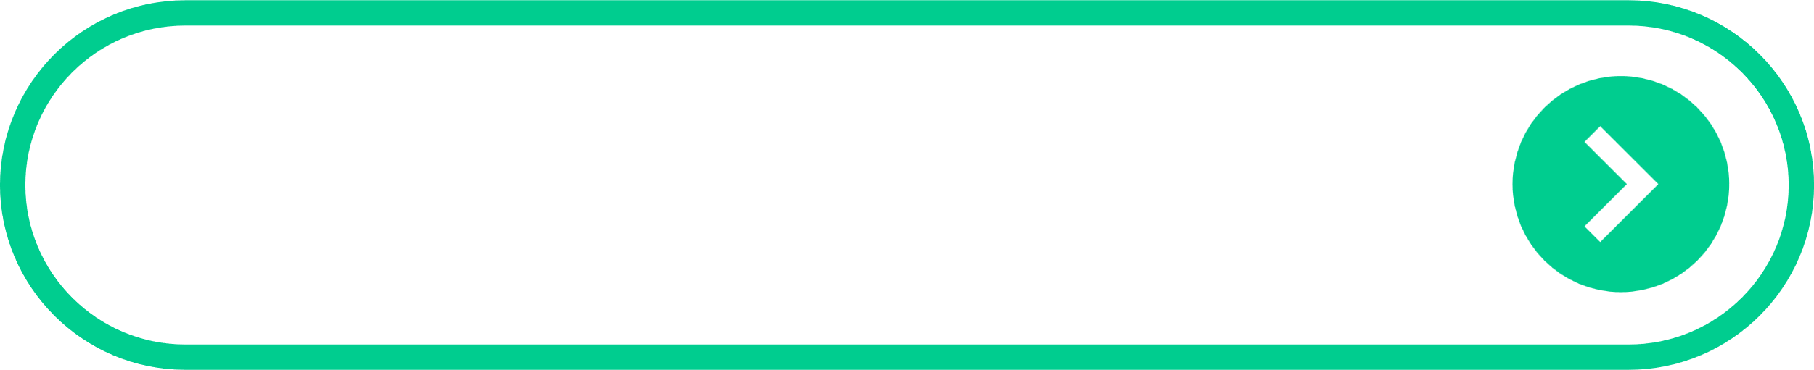


Starting Now
Engineering Graph RAG Agents: From Architecture to Production
Moving Beyond Brittle Assistants to Resilient, Reasoning Systems
Anthony ALCARAZ
Senior AI/ML Strategist AWS

Slide 2

Engineering Graph RAG Agents: From Architecture to Production
Context engineering in motion

Slide 3
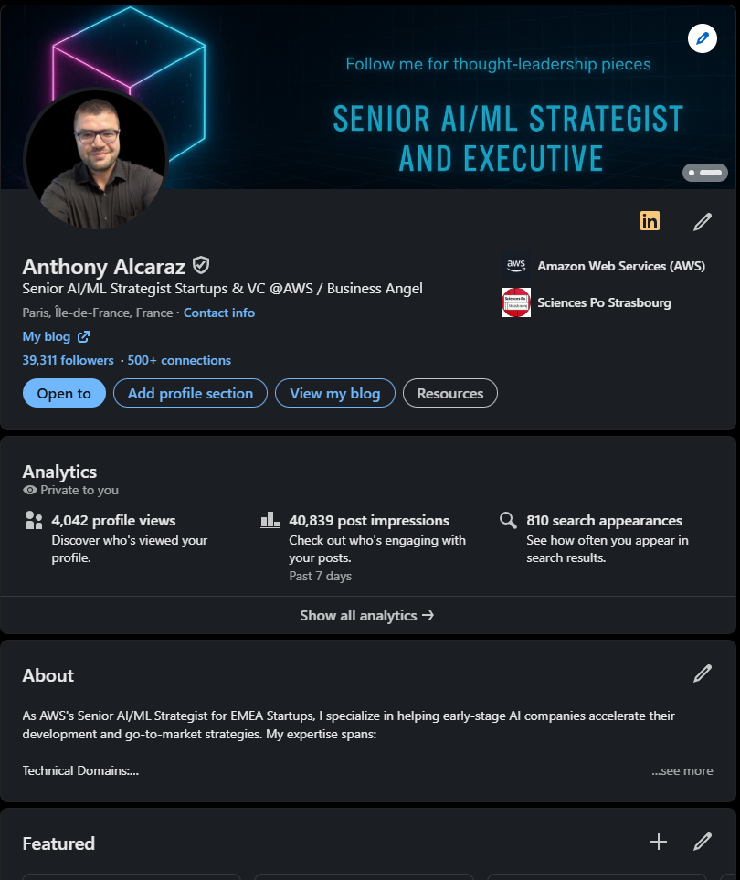
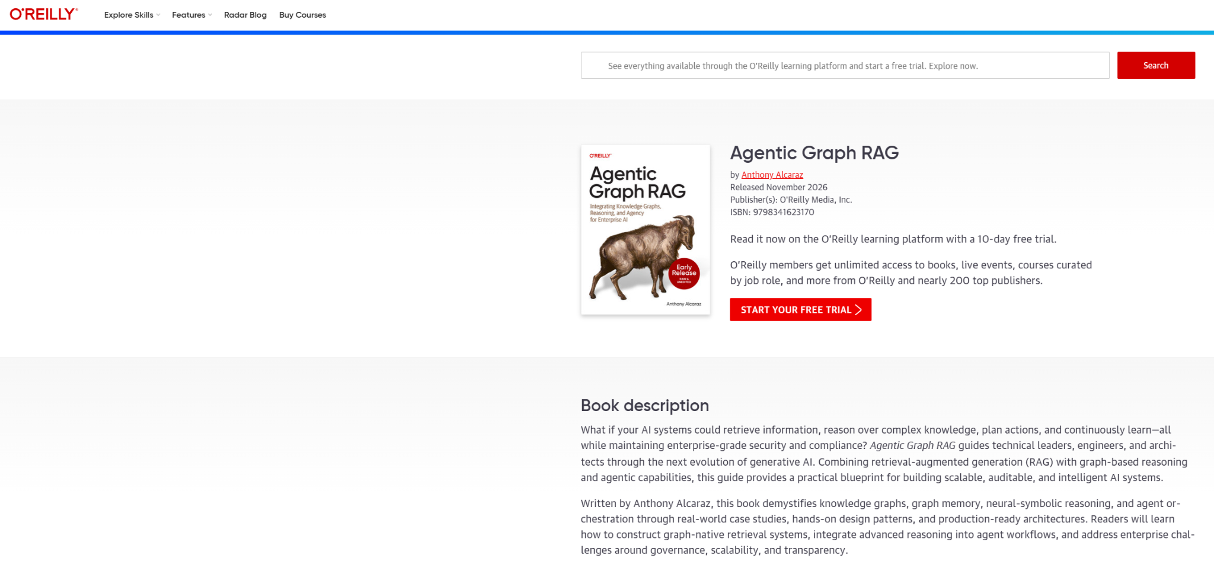
About Anthony ALCARAZ
As AWS's Senior AI/ML Strategist for EMEA Startups, I specialize in helping early-stage AI companies accelerate their technical development and go-to-market strategies.
I'm passionate about helping VCs and founders navigate the challenges of building transformative AI companies.
Anthony ALCARAZ
Senior AI/ML Strategist AWS

Slide 4
Agenda
01
Introduction - The Agentic Imperative
02
The Foundational Shift - Why Graphs?
03
The Agentic Spectrum & The Dual-Graph Architecture
04
Engineering the Architecture in Practice
From Architecture to Production
05

Slide 5
Introduction - The Agentic Imperative

Slide 6
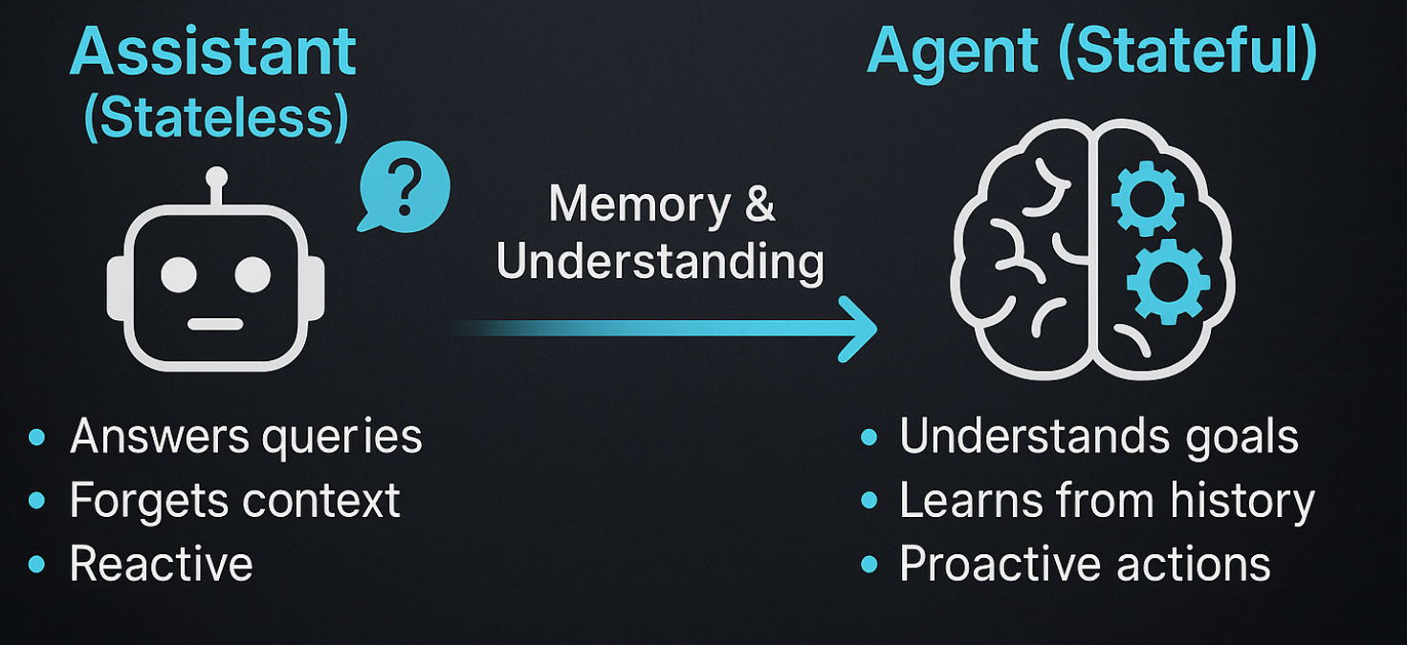
Introduction - The Agentic Imperative
The Core Problem - Your LLM is Amnesia Incarnate
>
Pg: 1
Notes:
Let's start with a blunt truth: the Large Language Models we use today are amnesia incarnate. Every conversation starts from scratch. There's no memory of past interactions, no ability to build expertise, and no capacity to learn from mistakes. It's like hiring a brilliant employee who forgets everything the moment they leave the room.
This isn't a minor bug; it's a fundamental architectural failure. It's the reason our current AI systems are great assistants but poor agents.
An assistant responds to your questions: "What is our current inventory?"
An agent pursues your goals: It notices declining inventory, predicts a stockout, evaluates suppliers, and places a new order—all while you sleep.
To make this leap, agents need more than data; they need understanding.

Slide 7
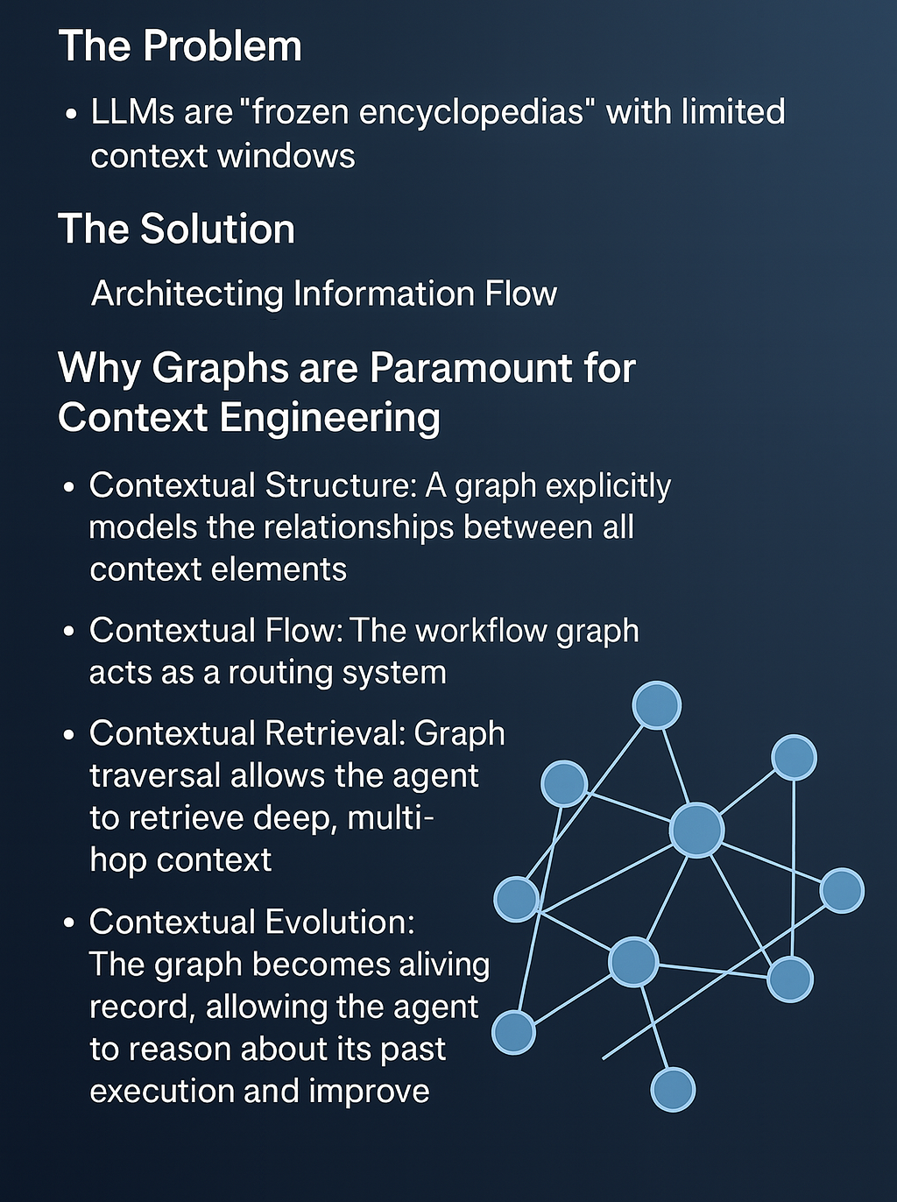
Introduction - The Agentic Imperative
Context Engineering: The Core Discipline
>
Pg: 1
Notes:
The Problem: LLMs are "Frozen Encyclopedias" with limited context windows. We cannot simply dump all available information and hope for the best. Most agent failures stem not from a lack of intelligence, but from being given poor, incomplete, or irrelevant context.
The Solution: Architecting Information Flow Context Engineering is the discipline of building dynamic systems that "weave together" the right information, tools, and format to enable an agent to successfully accomplish a task. This is the core of building agenticght systems.
Why Graphs are Paramount for Context Engineering: A graph is the architectural blueprint that makes sophisticated context engineering possible.
Contextual Structure: A graph explicitly models the relationships between all context elements—facts, memory, tools, user profiles. It transforms a flat list of information into a coherent, navigable web of understanding.
Contextual Flow: The workflow graph acts as a routing system, ensuring that each step in a process receives only the precise, surgically-scoped context it needs, preventing contamination and overload.
Contextual Retrieval: Graph traversal allows the agent to retrieve deep, multi-hop context ("the engineer who worked on the server that failed last quarter") that is impossible to find with keyword or vector search alone.
Contextual Evolution: The graph provides a structured medium for the agent to learn. Its own "Execution Graph" becomes a new source of context, allowing it to reason about its past performance and improve.

Slide 8
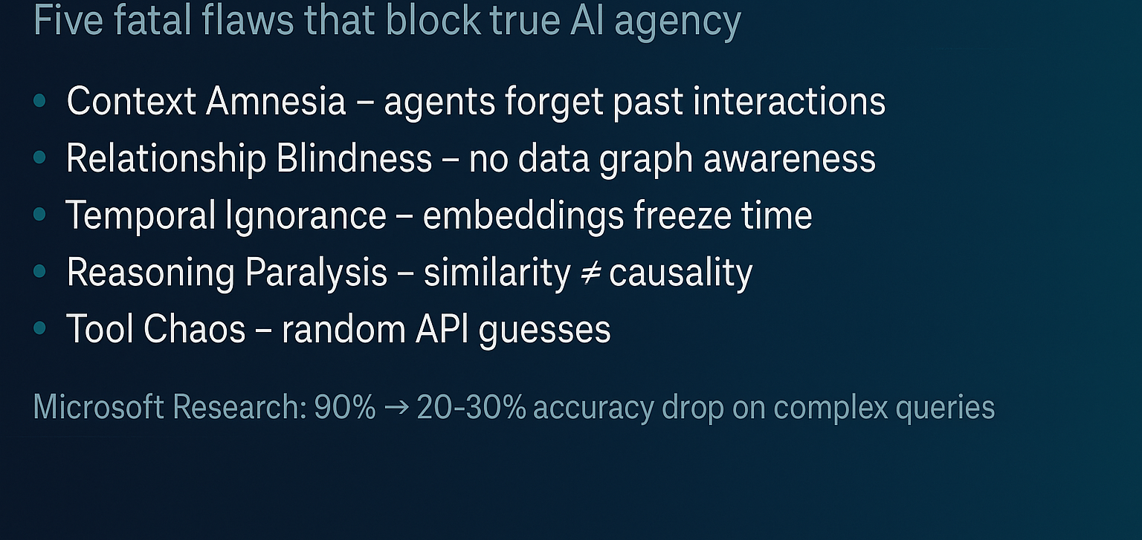
Introduction - The Agentic Imperative
The Failure of Traditional RAG at Scale
>
Pg: 1
Notes:
The industry's first attempt to solve this was Retrieval-Augmented Generation, or RAG. We hook an LLM up to a vector database and hope for the best. This created five fatal flaws that make true agency impossible:
Context Amnesia: Every query is isolated. Last week's vendor problem has no connection to this week's supply chain failure.
Relationship Blindness: Your data sits in silos. The agent sees a "customer" and a "purchase" but not the rich web of relationships connecting them.
Temporal Ignorance: Static embeddings can't capture change. The agent treats last year's server configuration as current truth, leading to dangerous actions.
Reasoning Paralysis: Vector search finds similar text, not logical connections. Ask it about the cascading effects of a system failure, and you'll get silence.
Tool Chaos: The agent guesses which API to call instead of orchestrating a complex workflow.
Research from Microsoft quantifies this disaster. While vector RAG is great for simple, specific questions (90%+ accuracy), its performance catastrophically fails on complex, analytical queries, plummeting to 20-30% accuracy.

Slide 9
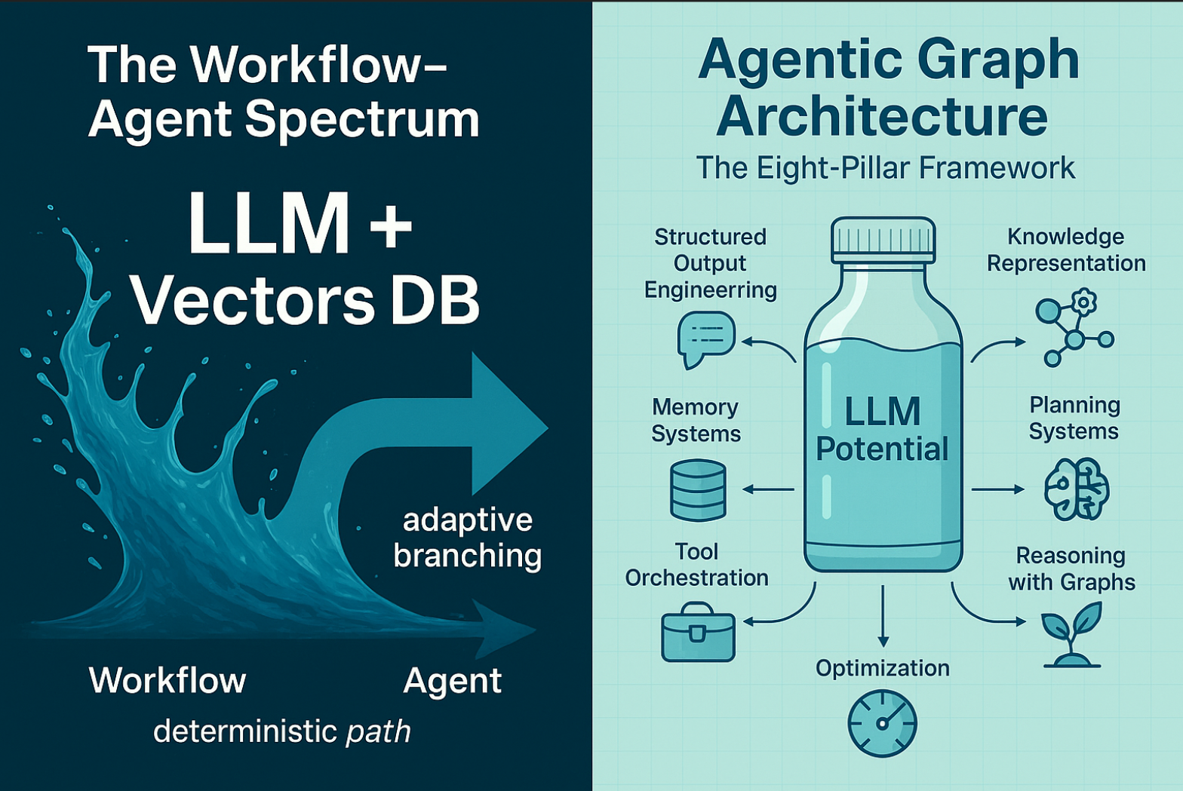
Introduction - The Agentic Imperative
The Eight-Pillar Framework for True Agency
>
Pg: 1
Notes:
Today, we're going to lay out a new blueprint for engineering resilient, reasoning agents. Our agenda is built around the Eight Pillars of Agentic Architecture:
The Foundational Shift: Why Graphs are the only reliable core.
A New Blueprint: The Dual-Graph Architecture & The Agentic Spectrum.
The Cognitive Core: We will then dive deep into the essential pillars:
Knowledge & Memory: Building a mind that remembers and evolves.
Reasoning & Planning: Structuring thought and strategy.
Action & Tooling: Interacting with the world reliably.
From Architecture to Production: How to optimize, secure, and build self-evolving systems.
Our core thesis is this: The future of AI is not about building bigger models, but about engineering smarter cognitive architectures.

Slide 10
Part 2: The Foundational Shift & The Dual-Graph Architecture

Slide 11
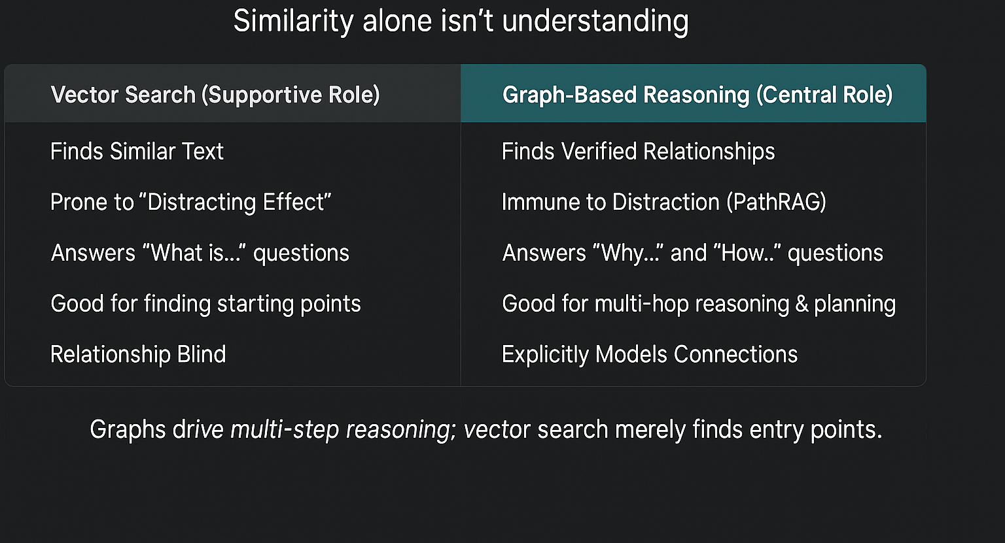
The Foundational Shift & The Dual-Graph Architecture
Why Graphs are More Reliable than Vector Search
>
Pg: 1
Notes:
The central limitation of vector-based RAG is that it operates on statistical similarity, not structural truth. It can tell you that two documents sound alike, but it can't tell you how they are logically connected.
Vector Search (Supportive Role)
Graph-Based Reasoning (Central Role)
Finds Similar Text
Finds Verified Relationships
Prone to "Distracting Effect"
Immune to Distraction (PathRAG)
Answers "What is..." questions
Answers "Why..." and "How..." questions
Good for finding starting points
Good for multi-hop reasoning & planning
Relationship Blind
Explicitly Models Connections
The graph must be the central component of a reasoning system, while other retrieval methods, like vector search, become supporting tools. Vector search is excellent for the first step—finding potential entry points into the knowledge graph. But the actual reasoning—the multi-step, cause-and-effect analysis—can only happen by traversing the verified relationships within the graph.

Slide 12
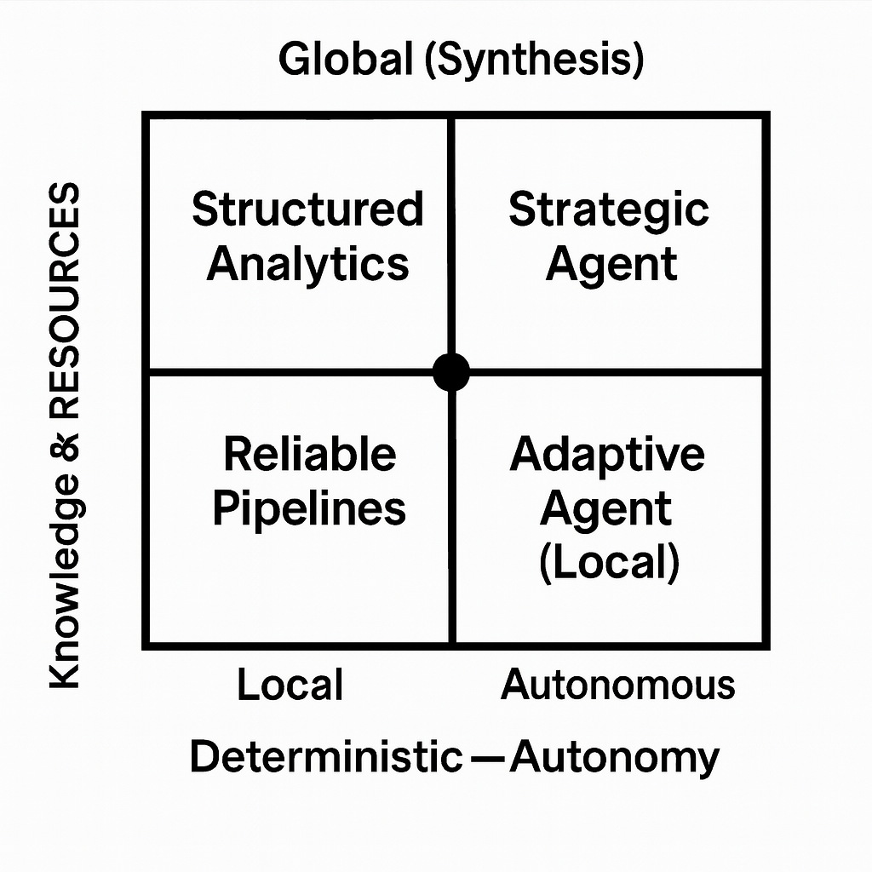
Part 2: The Foundational Shift & The Dual-Graph Architecture
Agentic as a Spectrum & The Dual-Graph Architecture
>
Pg: 1
Notes:
"Agentic" is not a binary switch. It’s a spectrum. Effective agentic systems must find equilibrium between two fundamental tensions: the determinism-autonomy spectrum and the local-global query spectrum. The Dual-Graph Architecture is the solution that allows us to navigate both.
(Image: A 2x2 grid. Horizontal axis is "Workflow Graph (HOW)". Vertical axis is "Knowledge & Tool Graph (RESOURCES)".)
The Horizontal Axis: The Workflow Graph (Process)
This governs HOW an agent acts. It’s the agent's conscious, decision-making process, allowing it to move along the determinism-autonomy spectrum.
The Vertical Axis: The Knowledge & Tool Graph (Resources)
This governs WHAT an agent knows and can do. It allows the agent to navigate the local-global query spectrum by accessing both specific facts and synthesized, holistic knowledge.
The graph architecture resolves these tensions by acting as a dynamic "cursor," enabling the agent to position itself on both spectrums based on context. It provides the structure for reliable, deterministic actions when needed, and the flexibility for autonomous, global reasoning when required. This architecture is the foundation for proper context engineering.

Slide 13
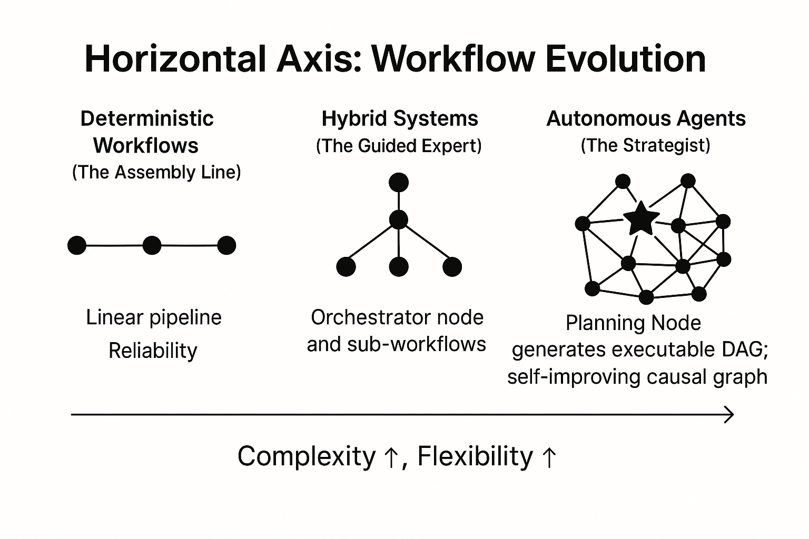
Part 2: The Foundational Shift & The Dual-Graph Architecture
The Horizontal Graph: Engineering the Process of Thought
>
Pg: 1
Notes:
The Horizontal Axis is where we engineer the agent's actions, moving from simple sequences to complex strategies.
(Image: A visual spectrum from a simple line, to a branching tree, to a complex, interconnected graph.)
Deterministic Workflows (The Assembly Line):
Structure: Simple, linear pipelines where Step B always follows Step A.
Use Case: High-stakes, regulated tasks like financial transactions. Reliability is paramount; creativity is a bug.
Hybrid Systems (The Guided Expert):
Structure: A central orchestrator node classifies a task and routes it to specialized sub-workflows. This is the enterprise sweet spot.
Parallelism: This structure allows for intelligent parallelism. The decision hinges on task dependency.
Use Parallel Processing: For independent subtasks (like researching multiple competitors simultaneously) to gain speed on I/O-bound tasks.
Use Sequential Processing: When subtasks are highly dependent and require a consistent state to be passed between them.
Autonomous Agents (The Strategist):
Structure: Here we introduce the Planning Node. Its job is not to execute, but to generate a plan.
A Plan is a Graph: The Planning Node's output is an executable Directed Acyclic Graph (DAG). Each node in this DAG is a task for a specialist agent, and the edges define dependencies.
Self-Improving Strategy: The most advanced autonomous agents are initialized with a causal graph, representing known cause-and-effect relationships. This allows the Planning Node to not only generate more robust initial plans but also to learn from outcomes. Successful plans strengthen causal links, while failures trigger re-evaluation, enabling the agent to continuously improve its own strategic model over time.
Use Case: For open-ended problems (e.g., "Analyze a company's market position") where the solution path is not known in advance and must be constructed dynamically. This separates high-level strategy from low-level execution.

Slide 14
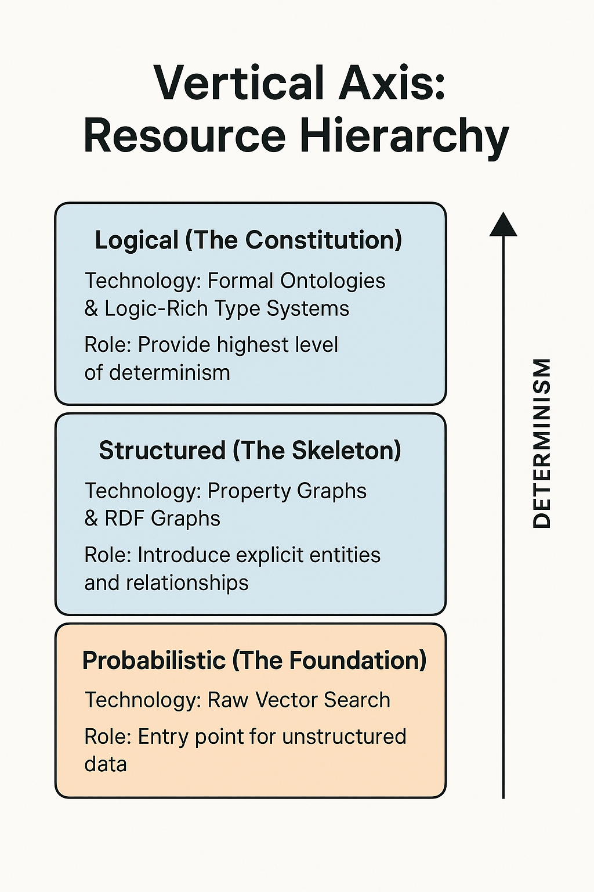
Part 2: The Foundational Shift & The Dual-Graph Architecture
The Vertical Graph: Engineering the Agent's World Model
>
Pg: 1
Notes:
The Vertical Axis is the agent's universe of resources. It also has its own spectrum, moving from fuzzy and probabilistic to precise and deterministic.
(Image: A layered diagram. Bottom layer is "Probabilistic," middle is "Structured," top is "Logical.")
The Probabilistic Layer (The Foundation):
Technology: Raw Vector Search.
Role: This is the entry point for unstructured data. It excels at finding semantically similar concepts but is inherently "fuzzy" and has no understanding of logic or structure.
Use Case: Finding initial, potentially relevant documents or graph nodes to begin a reasoning process.
The Structured Layer (The Skeleton):
Technology: Property Graphs & RDF Graphs.
Role: Here we introduce explicit entities and relationships. Property Graphs are flexible and performant; RDF Graphs add formal semantics for more rigorous reasoning.
Synergy: This layer combines vector search with graph constraints. We can use vectors to find candidate nodes, then traverse the structured graph to verify relationships and gather provable context.
The Logical Layer (The Constitution):
Technology: Formal Ontologies (OWL) & Logic-Rich Type Systems (DTT).
Role: This provides the highest level of determinism. The fundamental rules of the domain are baked into the data model itself.
Benefit: It becomes impossible for the agent to even represent an illogical state (e.g., a person born after they died). This provides a rock-solid foundation of truth for the agent's most critical decisions.

Slide 15
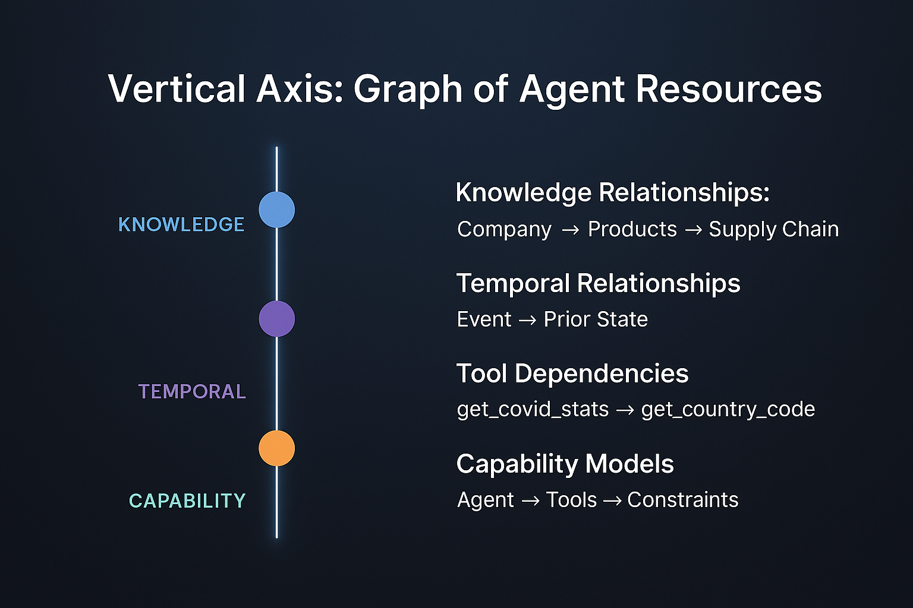
Part 2: The Foundational Shift & The Dual-Graph Architecture
Why the Vertical Axis MUST Be a Graph
>
Pg: 1
Notes:
The Vertical Axis represents the agent's entire universe of resources. A simple list or vector database is insufficient because resources are not isolated; they are deeply interconnected. A graph is the only structure that can capture this rich web of relationships.
Knowledge Relationships: It connects a Company to its Products, and those Products to their Supply Chain data. This enables holistic understanding.
Temporal Relationships: It connects an Event to the State that preceded it, enabling true temporal reasoning.
Tool Dependencies: It connects a get_covid_stats tool to the get_country_code tool it REQUIRES as an input. This transforms complex planning into simple traversal.
Capability Models: It connects an Agent to the Tools it has permission to use, and the Constraints (e.g., budget limits) on that usage.
Without a graph, the agent is blind to these connections. It can see the resources but cannot understand how they work together. The graph provides the semantic wiring that connects everything the agent knows and can do into a coherent, navigable whole.

Slide 16
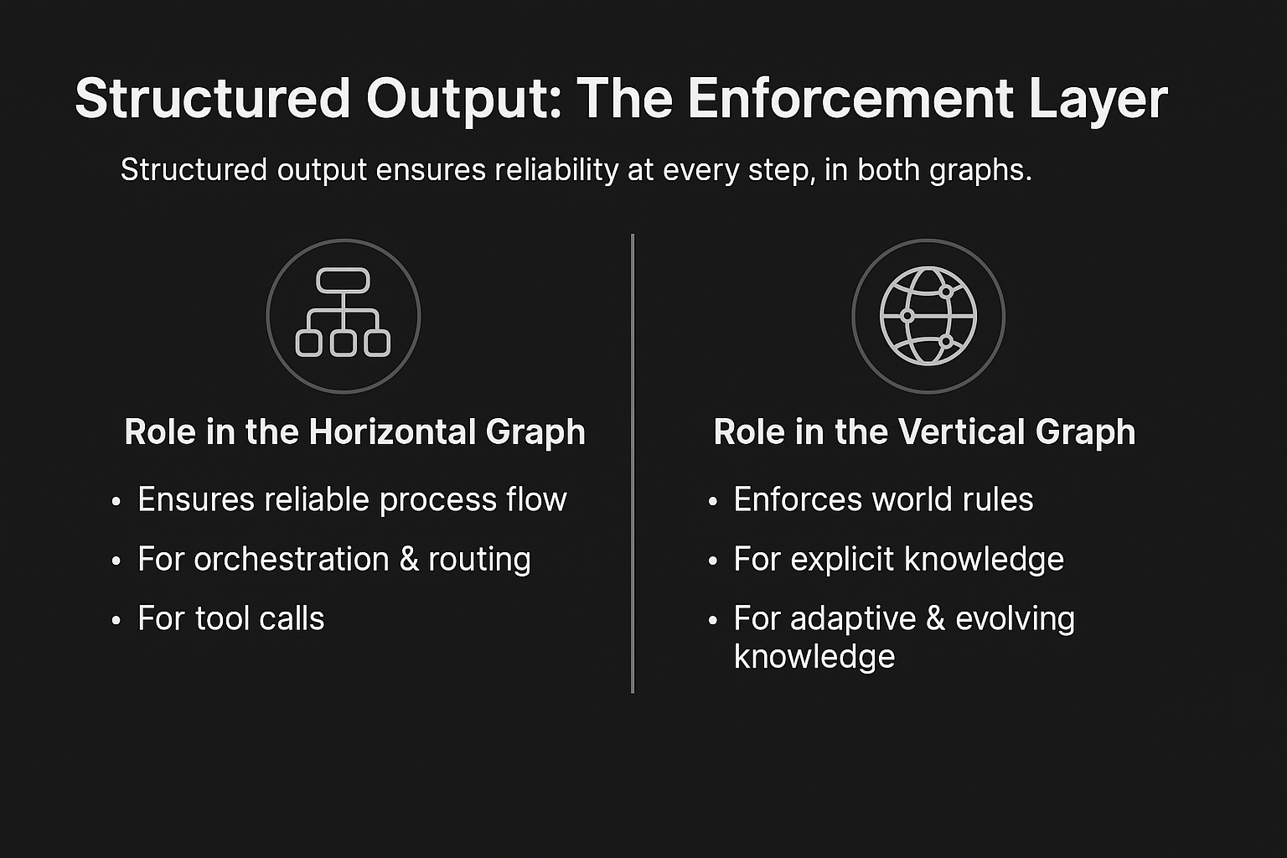
Part 2: The Foundational Shift & The Dual-Graph Architecture
The Role of Structured Output in the Vertical Graph
>
Pg: 1
Notes:
If the dual graphs define the rules and the process, Structured Output is the enforcement mechanism that guarantees reliability at every single step. It is the unbreakable contract between nodes.
1. Role in the Horizontal Graph (Ensuring Reliable Process Flow): The Horizontal Graph orchestrates what to do next. Structured output ensures the handoff between steps is perfect.
For Orchestration & Routing: A central "router" agent's most critical job is to decide which specialist node to call next. By forcing its output into a Literal["Search_Node", "Purchase_Node"] format, we guarantee the workflow proceeds correctly. Without this, a slightly malformed decision like "I think we should go to the search node" would cause the entire process to fail.
For Tool Calls: An agent's decision to act must translate into a perfect, machine-readable command. Structured output, constrained by a tool's function signature, guarantees the generated API call is syntactically flawless.
2. Role in the Vertical Graph (Enforcing World Rules): The Vertical Graph defines the rules of the world. Structured output ensures the agent obeys them.
For Explicit Knowledge: When adding data to a database, forcing the LLM's output to match a Pydantic schema of the database table ensures perfect data integrity.
For Adaptive Knowledge: When an agent retrieves a "Cardiology Report" ontology, structured output uses that specific ontology as a runtime constraint to guide information extraction, making the adaptive guardrail a reality.
For Evolving Knowledge: When an agent decides to create a new schema for a new type of data, structured output allows it to reliably use its own newly-created rule for all future tasks.
In short: the Vertical Graph defines what's possible, the Horizontal Graph defines the path, and Structured Output ensures every step on that path is taken without stumbling.

Slide 17
Part 3: The Cognitive Core

Slide 18
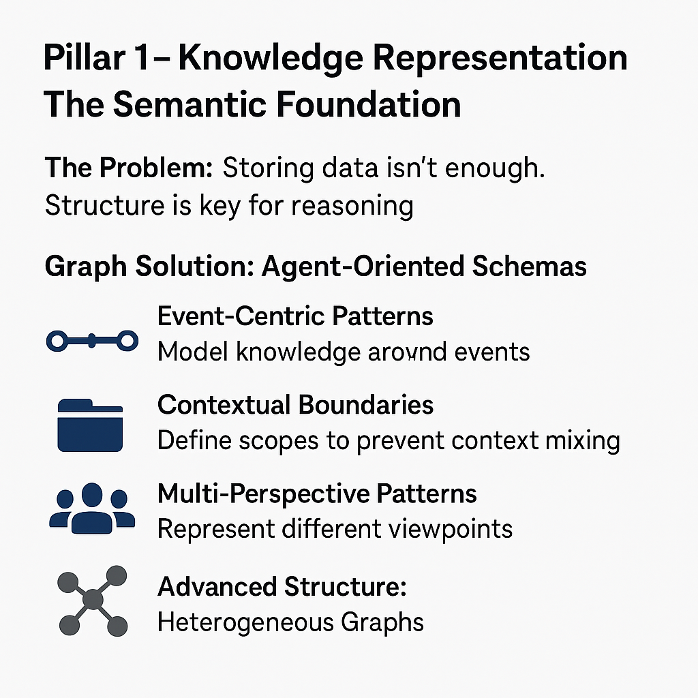
Part 3: The Cognitive Core
Pillar 1 - Knowledge Representation: The Semantic Foundation
>
Pg: 1
Notes:
(Slide 11: Pillar 1 & 2 - Knowledge Representation & Graph Memory)
An agent's mind is built on its knowledge and memory. Traditional approaches fail because context windows are not memory; they are a temporary, amnesiac scratchpad. This is why users complain, "Why doesn't it remember me?"
The Graph Solution: Agentic Memory Management. We move beyond simple storage to a system where the agent actively manages its own mind. This is a multi-layered, living memory architecture.
Hierarchical Memory (The Letta/MemGPT Pattern): We mirror human cognition with tiered memory to solve the context window limit.
Core Memory: A small, fast "working memory" for immediately relevant facts.
Archival Memory: A vast, searchable graph for long-term knowledge.
The agent intelligently evicts less relevant information from Core to Archival memory.
Intelligent Consolidation: The agent learns to transform raw, short-term interactions (Episodic Memory) into structured, long-term understanding (Semantic Memory), discarding noise and retaining insights. This process is informed by bi-temporal modeling, which tracks both when an event happened and when the agent learned about it.
The MEM1 Revolution: Learned Memory Strategies:
The Flaw: Trying to hand-craft complex rules for what an agent should remember is brittle and fails at scale.
The Breakthrough: We stop telling the agent how to remember. Instead, we train it with memory constraints and reward task success.
Emergent Strategy: The agent learns the most efficient memory strategies for its goals. It discovers on its own what is important versus what is trivial, developing consolidation techniques that outperform anything we could engineer by hand. A 7B model with learned memory strategies can beat a 70B model with engineered ones.

Slide 19
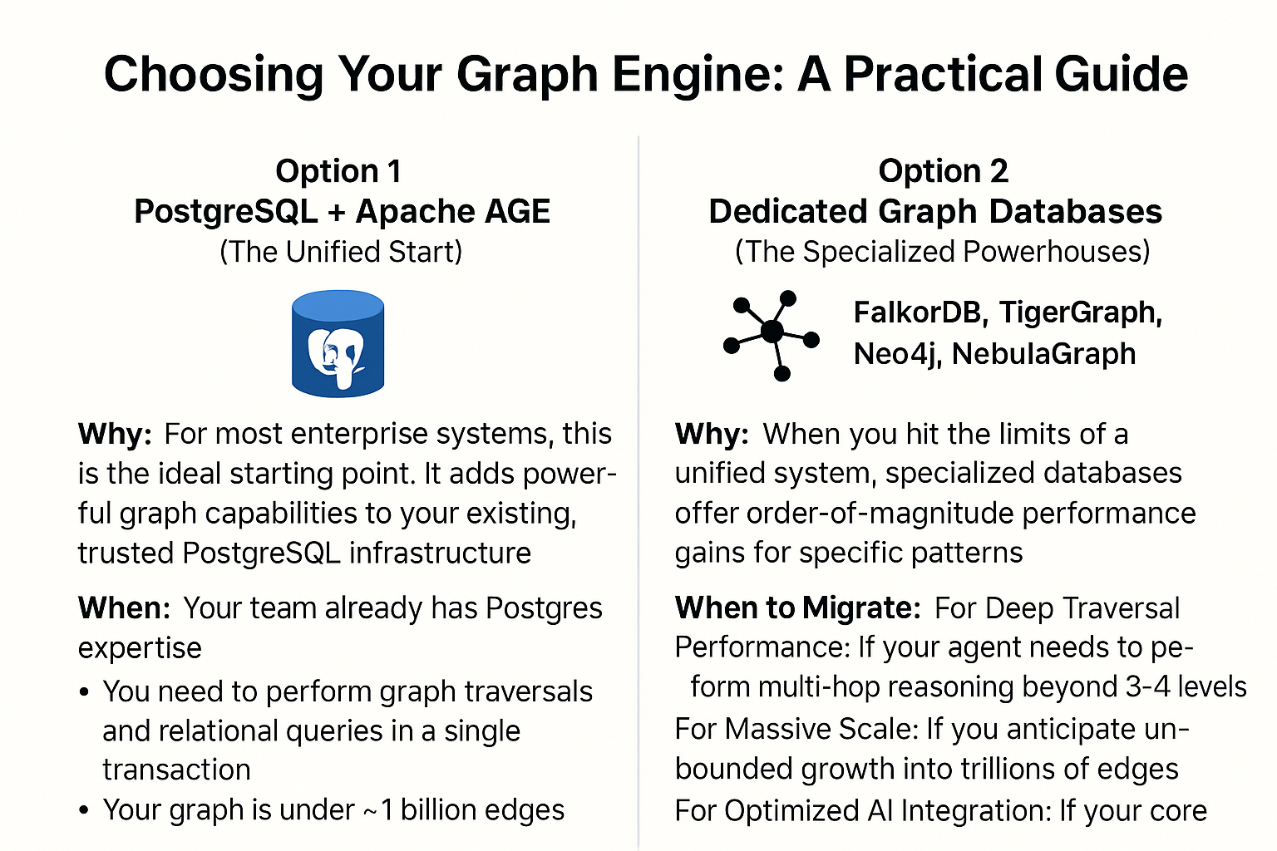
Part 3: The Cognitive Core
Pillar 1 - Knowledge Representation: The Semantic Foundation
>
Pg: 1
Notes:
Choosing Your Graph Engine: A Practical Guide
Option 1: PostgreSQL + Apache AGE (The Unified Start)
Why: For most enterprise systems, this is the ideal starting point. It adds powerful graph capabilities to your existing, trusted PostgreSQL infrastructure, creating a unified data model for relational, vector, and graph data.
When: Your team already has Postgres expertise; you need to perform graph traversals and relational queries in a single transaction; your graph is under ~1 billion edges.
Option 2: Dedicated Graph Databases (The Specialized Powerhouses)
Why: When you hit the limits of a unified system, specialized databases offer order-of-magnitude performance gains for specific patterns.
When to Migrate:
For Deep Traversal Performance: If your agent needs to perform multi-hop reasoning beyond 3-4 levels, native graph databases like FalkorDB or TigerGraph can be 10-1000x faster.
For Massive Scale: If you anticipate unbounded growth into trillions of edges, horizontally scalable databases like NebulaGraph are essential.
For Optimized AI Integration: If your core workload is GraphRAG, purpose-built solutions like FalkorDB (90% accuracy on benchmarks) or Neo4j (direct LLM plugins) can provide superior performance.
The Strategy: Start with PostgreSQL + AGE to validate your architecture without operational overhead. Instrument your queries to understand your real-world usage patterns. This data will tell you if, and when, you need to migrate to a specialized powerhouse.

Slide 20
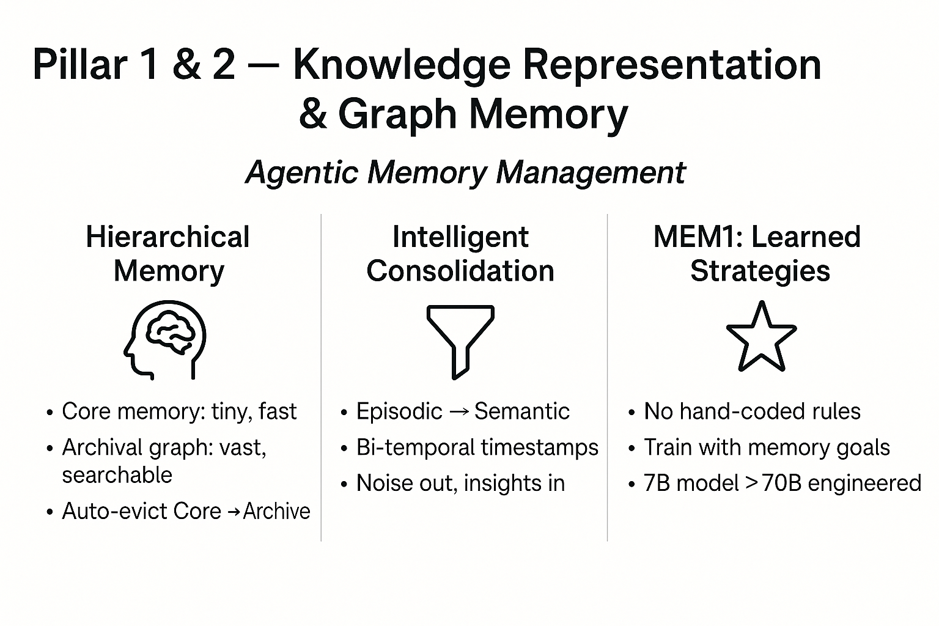
Part 3: The Cognitive Core
Pillar 1 & 2 - Knowledge Representation & Graph Memory
>
Pg: 1
Notes:
(Slide 11: Pillar 1 & 2 - Knowledge Representation & Graph Memory)
An agent's mind is built on its knowledge and memory. Traditional approaches fail because context windows are not memory; they are a temporary, amnesiac scratchpad. This is why users complain, "Why doesn't it remember me?"
The Graph Solution: Agentic Memory Management. We move beyond simple storage to a system where the agent actively manages its own mind. This is a multi-layered, living memory architecture.
Hierarchical Memory (The Letta/MemGPT Pattern): We mirror human cognition with tiered memory to solve the context window limit.
Core Memory: A small, fast "working memory" for immediately relevant facts.
Archival Memory: A vast, searchable graph for long-term knowledge.
The agent intelligently evicts less relevant information from Core to Archival memory.
Intelligent Consolidation: The agent learns to transform raw, short-term interactions (Episodic Memory) into structured, long-term understanding (Semantic Memory), discarding noise and retaining insights. This process is informed by bi-temporal modeling, which tracks both when an event happened and when the agent learned about it.
The MEM1 Revolution: Learned Memory Strategies:
The Flaw: Trying to hand-craft complex rules for what an agent should remember is brittle and fails at scale.
The Breakthrough: We stop telling the agent how to remember. Instead, we train it with memory constraints and reward task success.
Emergent Strategy: The agent learns the most efficient memory strategies for its goals. It discovers on its own what is important versus what is trivial, developing consolidation techniques that outperform anything we could engineer by hand. A 7B model with learned memory strategies can beat a 70B model with engineered ones.

Slide 21
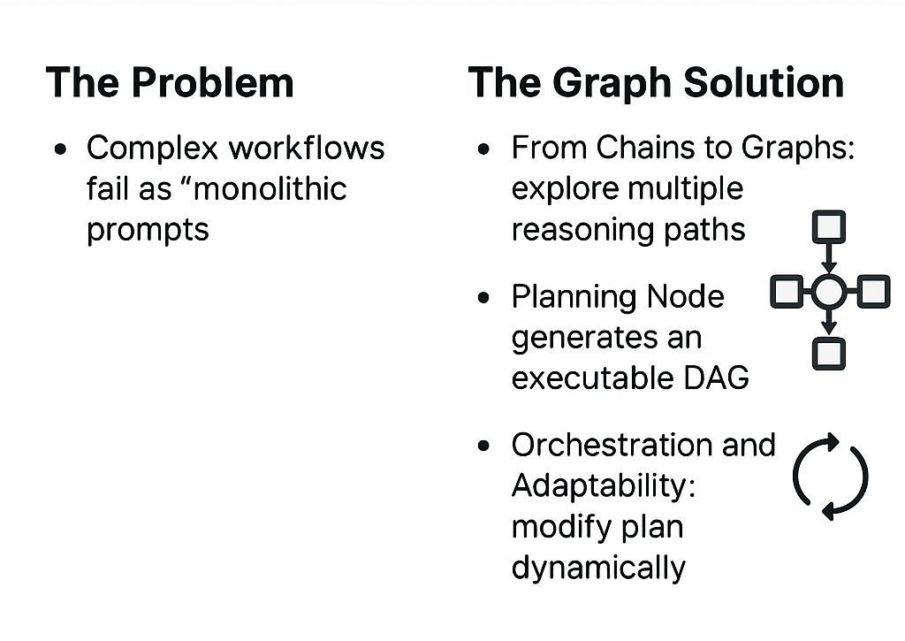
Part 3: The Cognitive Core
Pillar 3 & 4 - Reasoning & Graph-Based Planning
>
Pg: 1
Notes:
Great agents don't just react; they plan. But you cannot encode a complex plan into a single prompt—that’s the "Monolithic Prompt Trap."
The Problem: Trying to define a complex workflow in natural language leads to chaos, interference, and failure.
The Graph Solution: Engineering the Process of Thought We must engineer the process itself, moving beyond simple Chain-of-Thought.
From Chains to Graphs (GoT): We use frameworks like Graph-of-Thoughts, allowing the agent to explore multiple reasoning paths, merge findings, and loop back to refine earlier conclusions. This moves from linear to non-linear problem-solving.
The Planning Node as an Architect: In our workflow, a specialized Planning Node acts as a strategist. It receives a high-level goal and generates an executable Directed Acyclic Graph (DAG) as the plan. This plan is not text; it's a formal process model.
Orchestration and Adaptability: This DAG becomes an executable blueprint that orchestrates the federation of specialist nodes (retrieval, action, validation). Because the plan is a graph, it's not static. The system can perform contrastive reflection: if an execution node fails or returns an unexpected result, the plan can be dynamically modified. This creates a resilient agent that adapts its strategy mid-execution based on real-time feedback.

Slide 22
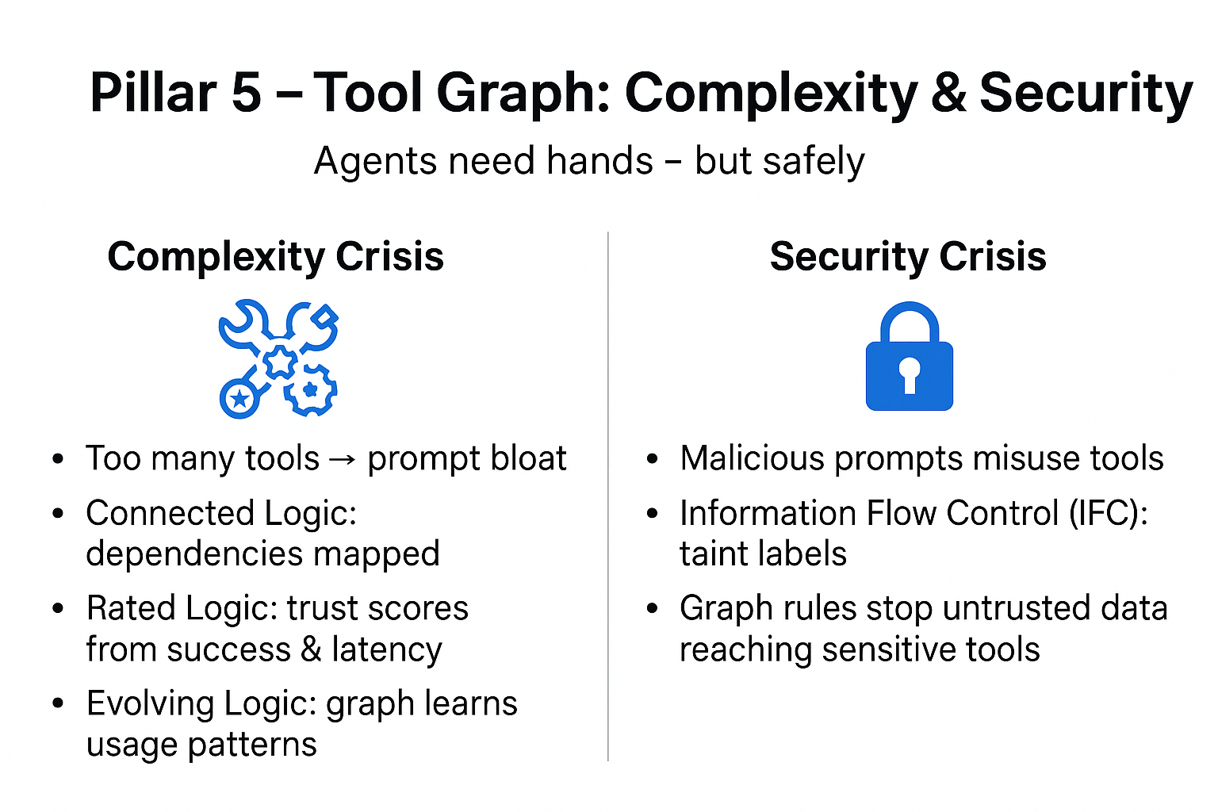
Part 3: The Cognitive Core
Pillar 5 & 6 - Tool Orchestration & Security: The Living Toolkit
>
Pg: 1
Notes:
Tools give agents hands, but this introduces crises of complexity and security. We must treat an agent's symbolic logic—its tools—as a first-class citizen of the knowledge graph.
The Complexity Crisis: From "Prompt Bloat" to a Self-Organizing Toolkit
The Problem: The "too many tools" problem paralyzes agents.
The Graph Solution: We model tools as evolving, rated, connected data in the graph.
Connected Logic: We explicitly model tool dependencies (Tool B REQUIRES output from Tool A). This transforms the impossible reasoning task of nested API calls into a simple, discoverable graph traversal.
Rated Logic: We create a meritocracy of tools. Instead of trusting a tool's description, we give it a trust score that evolves based on its real-world success rate, latency, and user feedback. The agent learns to prefer tools that actually work.
Evolving Logic: The graph learns from usage. It strengthens connections between tools used successfully together (COLT pattern) and refines its own understanding of a tool's true capabilities through systematic testing (DRAFT pattern).
The Security Crisis: From Malicious Influence to Deterministic Safety
The Problem: An attacker can trick an authorized agent into misusing its tools from the inside.
The Graph Solution: We build security into the fabric of the graph itself.
Information Flow Control (IFC): We "taint" data with trust labels (TRUSTED, UNTRUSTED). The graph's rules can then deterministically block the agent from passing untrusted data to a sensitive tool, neutralizing a whole class of agentic threats.

Slide 23
Part 3: The Cognitive Core
Pillar 5 & 6 - Tool Orchestration & Security: The Living Toolkit
>
Pg: 1
Notes:
Tools give agents hands, but this introduces crises of complexity and security. We must treat an agent's symbolic logic—its tools—as a first-class citizen of the knowledge graph.
The Complexity Crisis: From "Prompt Bloat" to a Self-Organizing Toolkit
The Problem: The "too many tools" problem paralyzes agents.
The Graph Solution: We model tools as evolving, rated, connected data in the graph.
Connected Logic: We explicitly model tool dependencies (Tool B REQUIRES output from Tool A). This transforms the impossible reasoning task of nested API calls into a simple, discoverable graph traversal.
Rated Logic: We create a meritocracy of tools. Instead of trusting a tool's description, we give it a trust score that evolves based on its real-world success rate, latency, and user feedback. The agent learns to prefer tools that actually work.
Evolving Logic: The graph learns from usage. It strengthens connections between tools used successfully together (COLT pattern) and refines its own understanding of a tool's true capabilities through systematic testing (DRAFT pattern).
The Security Crisis: From Malicious Influence to Deterministic Safety
The Problem: An attacker can trick an authorized agent into misusing its tools from the inside.
The Graph Solution: We build security into the fabric of the graph itself.
Information Flow Control (IFC): We "taint" data with trust labels (TRUSTED, UNTRUSTED). The graph's rules can then deterministically block the agent from passing untrusted data to a sensitive tool, neutralizing a whole class of agentic threats.

Slide 24
Part 4: From Architecture to Production

Slide 25
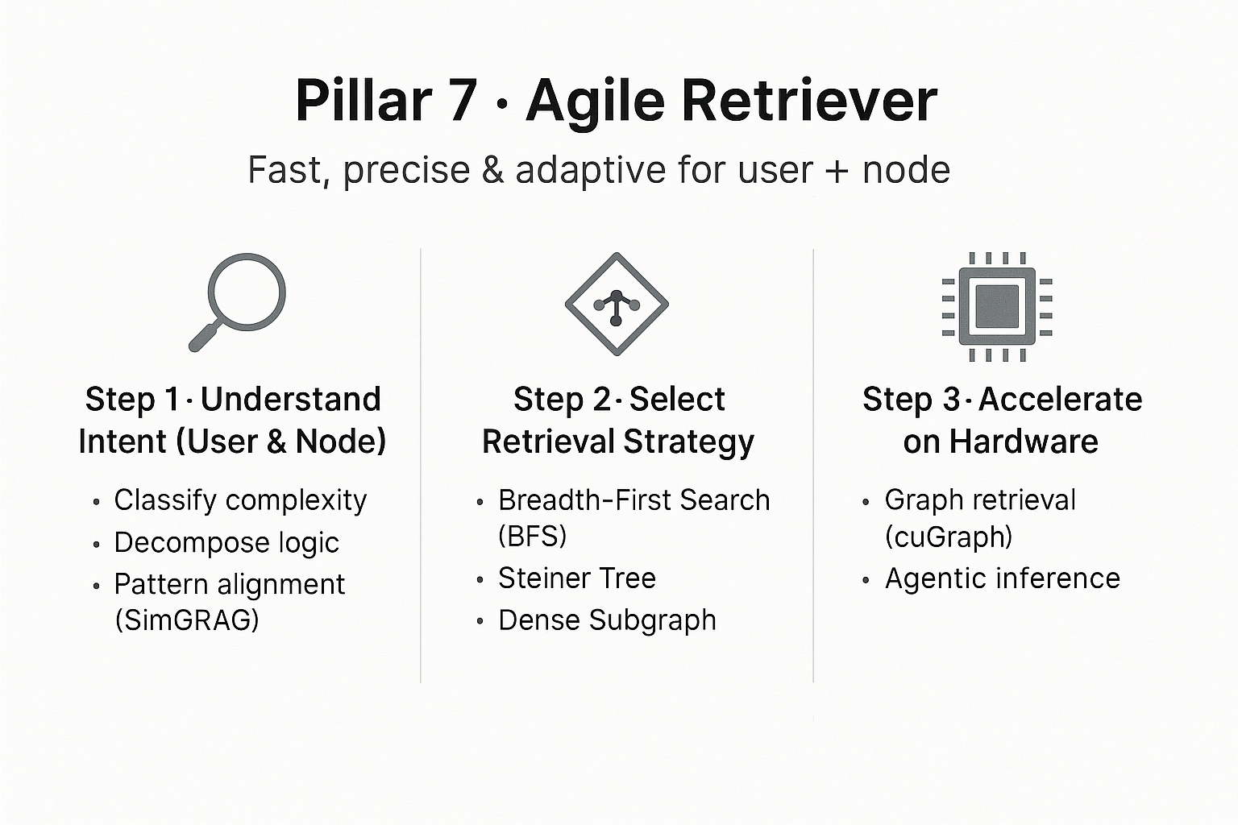
Part 4: From Architecture to Production
Pillar 7 - Optimization and The Agile Retriever
>
Pg: 1
Notes:
A brilliant brain is useless if its nervous system is slow. We need an Agile Retriever that is fast, precise, and adaptive. This is a multi-stage process that must serve two masters: the initial human user and the internal nodes of a complex workflow.
Step 1: Understand Intent (Both User and Node) The retriever must understand intent from two sources:
Deconstructing User Intent: For the initial, often ambiguous user query, we use an SLM to:
Classify Complexity: Is it a simple DataLocal query or a complex ActivityGlobal one?
Decompose Logic: Break down operators like AND, OR, NOT into formal expressions.
Align to Patterns (SimGRAG): Translate the query into a formal, machine-readable graph pattern.
Interpreting Node Intent: Within a multi-step plan, each node has a highly specific, machine-generated goal. The retriever's job is to fulfill this precise intent. For example, a Validation Node's intent is not just to "find facts," but to "retrieve the specific subgraph necessary to verify Claim X against Constraint Y."
Step 2: Select the Optimal Retrieval Strategy Based on this deep understanding of intent, the system selects the best algorithm.
For simple, local queries (user or node), we use Breadth-First Search (BFS) for comprehensive coverage.
For complex, deep queries (user or node), we use a Steiner Tree approximation to find the most efficient path.
For finding clusters of related information, we use Dense Subgraph retrieval.
Step 3: Execute with Accelerated Hardware Finally, we execute these tasks at production speed using Twin Engines of Performance:
Engine 1: Accelerated Graph Retrieval (cuGraph): Graph algorithms are limited by memory bandwidth. GPUs offer 10-20x more memory bandwidth than CPUs, allowing libraries like NVIDIA's cuGraph to run traversals and algorithms like PageRank 100-200x faster.
Engine 2: Accelerated Agentic Inference: A single query might trigger dozens of calls to our specialist SLMs. Specialized AI hardware makes this "cognitive supply chain" instantaneous, allowing the agent to "think" at the speed of conversation.

Slide 26
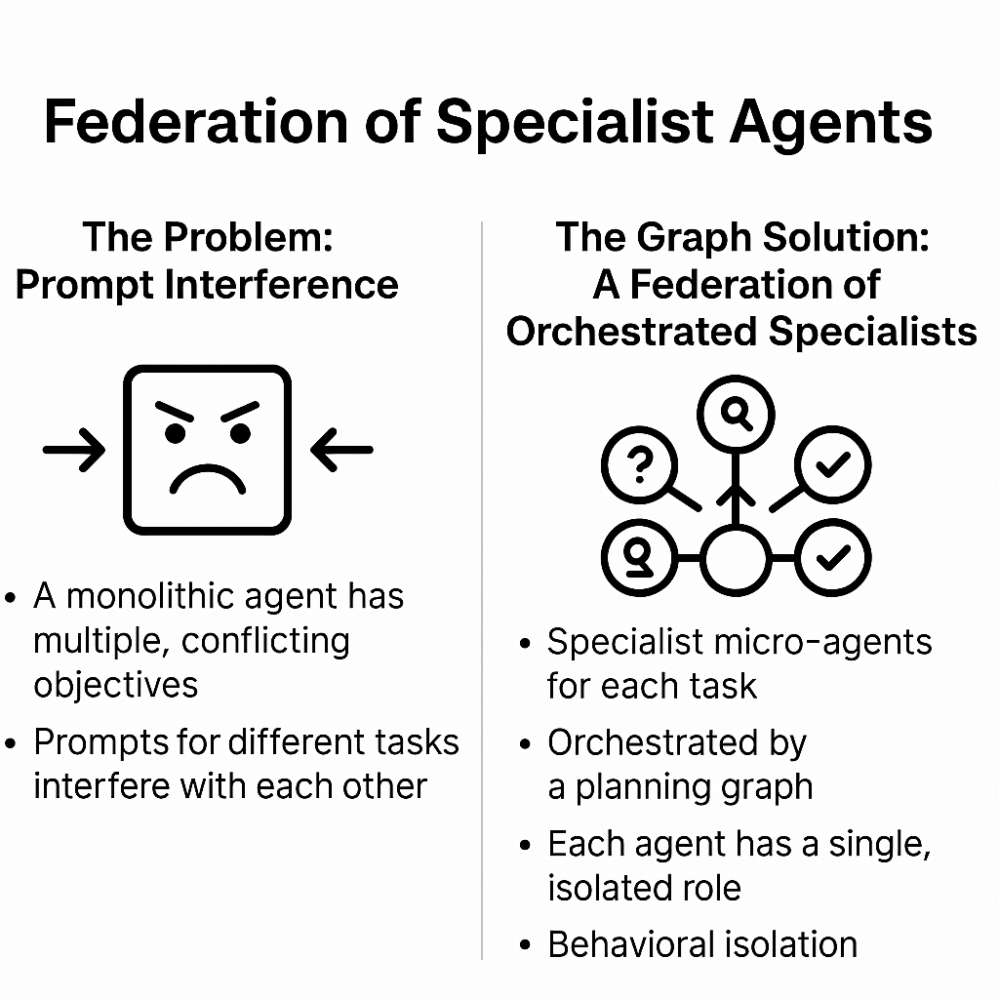
Part 4: From Architecture to Production
The Reasoning Engine - A Federation of Specialists
>
Pg: 1
Notes:
We apply the same principle of decomposition to the agent itself. The #1 enemy of reliability in production is the monolithic agent.
The Problem: Competing Objectives & Prompt Interference. A single, monolithic agent is brittle because it's forced to juggle multiple, often conflicting, objectives. Instructions to be conversational interfere with instructions for strict JSON formatting. Rules for tool selection interfere with rules for summarization. This "prompt interference" causes catastrophic failures, as seen in Kakao's initial shopping assistant, which had only a 65.5% task completion rate.
The Graph Solution: A Federation of Orchestrated Specialists. We decompose the "thinking" process into a federation of specialist micro-agents, orchestrated by our planning graph. Each node in the workflow is a specialist with one job, powered by a fit-for-purpose SLM.
Query Analyst Node: Its entire focus is deconstructing user intent into structured data. It doesn't know how to format a recommendation.
Retrieval Strategist Node: This node's only skill is selecting the optimal RGL algorithm based on the Analyst's output.
Synthesis Node: This agent excels at one thing: weaving structured graph data into coherent, human-readable language.
Validation Node: A highly constrained node that only checks for factual consistency between the final answer and the retrieved data.
The Power of Behavioral Isolation. This architecture creates behavioral isolation. The Synthesis Node is never trained on validation tasks, so its creative abilities aren't compromised. The Validation Node is never asked to be conversational, so its logical precision is never diluted. This is how Kakao transformed their agent's reliability, and how a 7-billion parameter specialist consistently outperforms a 70-billion parameter generalist trying to do everything at once.

Slide 27
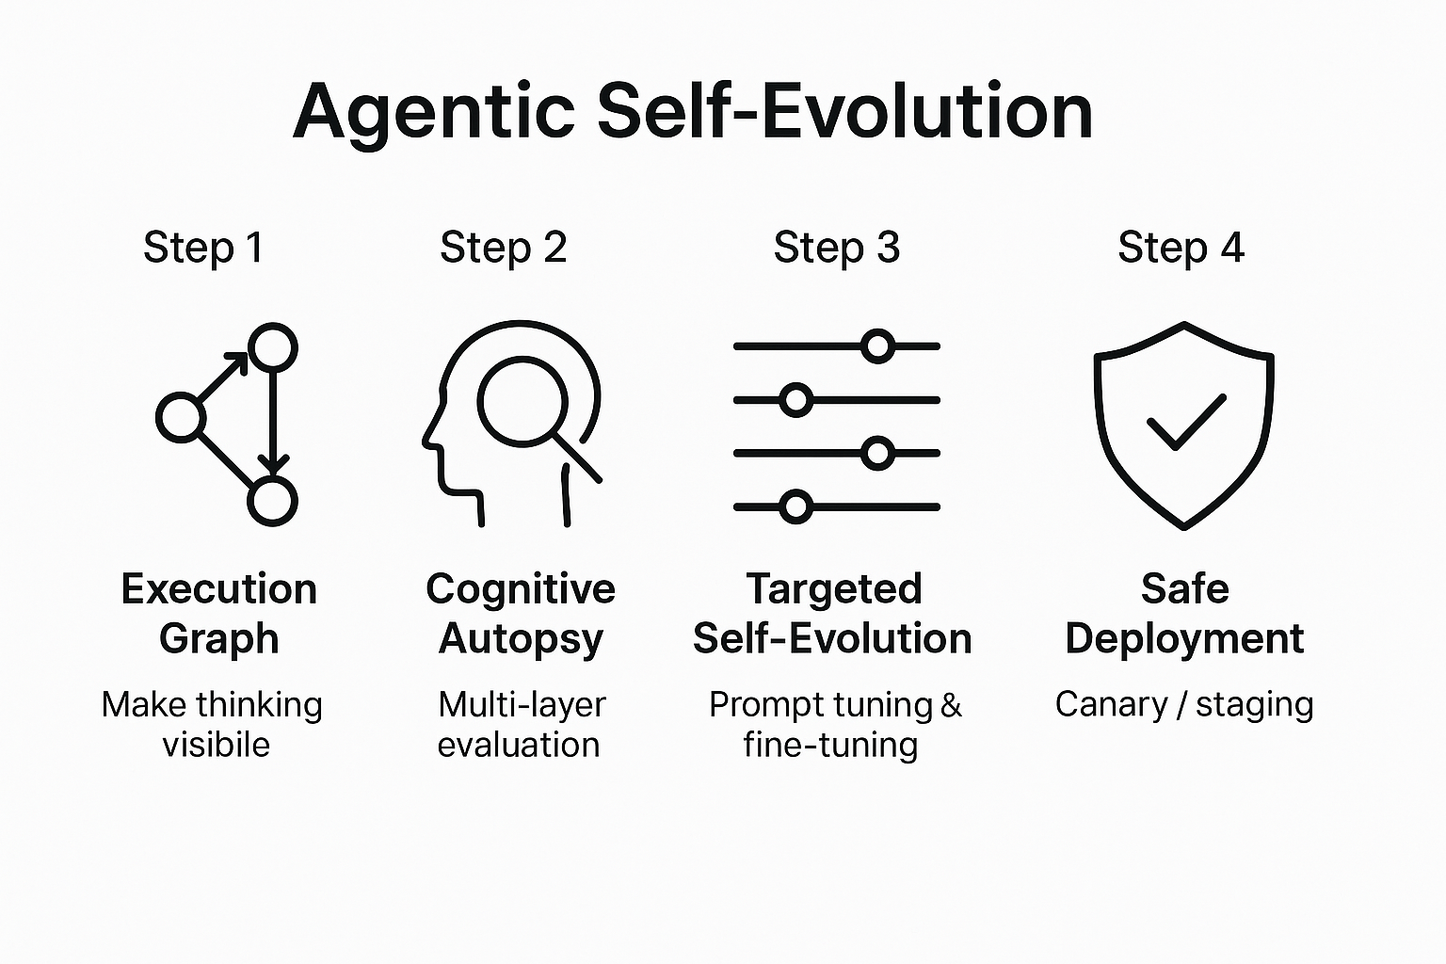
Part 4: From Architecture to Production
Pillar 8 - Safe, Continuous Evolution
>
Pg: 1
Notes:
A production system cannot be static; it must learn. The graph architecture is the key to creating a system that learns from its mistakes safely and systematically. This is Agentic Self-Evolution.
Step 1: Make Thinking Visible with an Execution Graph. For every task, we generate an Execution Graph—an immutable, queryable "autobiography" of the agent's thought process. This structured log makes diagnosis possible.
Step 2: Perform a "Cognitive Autopsy" with a Multi-Layered Evaluation Framework. An evaluation engine analyzes the execution graph to pinpoint the precise root cause of a failure. It answers key questions:
Was the context sufficient? Did the agent even have the information needed to succeed? We check for completeness and contradictions.
Was it a Knowledge or Reasoning Failure? If the context was sufficient, did the agent fail because it operated on bad facts (a knowledge failure) or because its logic was flawed (a reasoning failure)? We can measure this formally using metrics like Information Gain to see where the agent's logic went off track.
What are the Implicit Signals? We move beyond right/wrong to analyze user behavior signals. Did the user have to rephrase their query? Did they copy-paste the agent's answer? These are powerful indicators of true usefulness that simple accuracy scores miss.
Step 3: Self-Evolution via Targeted Interventions. The detailed diagnosis allows for precise fixes.
A localized reasoning failure triggers a prompt improvement.
A systemic knowledge gap triggers fine-tuning, using frameworks like SEAL to generate targeted training data for that specific weakness.
The system uses Semantic Backpropagation to ensure a fix in one specialist node doesn't cause unintended side effects in another.
Step 4: Deploy Safely. Finally, all changes are deployed through a Graduated Validation Protocol (Canary, Staging, Airlock) to manage risk. This creates a system that is simultaneously dynamic and safe, compounding its intelligence with every interaction.

Slide 28
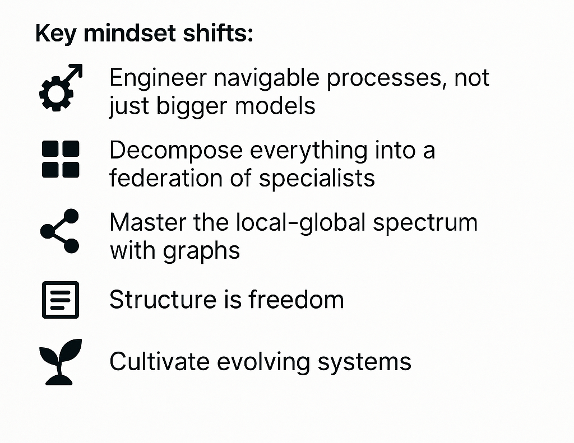
Part 4: From Architecture to Production
The Future is Engineered, Not Emergent
>
Pg: 1
Notes:
Today, we've journeyed from the architectural failures of traditional AI to a robust, production-ready blueprint for agentic systems built on eight pillars.
The key takeaways are a shift in mindset:
Engineer Better Processes, Not Just Bigger Models: Reliability comes from well-designed workflows, not from hoping for emergent intelligence.
Decompose Everything: Decompose problems, data, and the agent itself into a federation of specialists.
Embrace Selective Intelligence: Use your most powerful tools surgically, not as sledgehammers.
Structure is Freedom: Enforcing structured outputs and using graph structures doesn't limit the agent; it frees it to perform more complex reasoning reliably.
Cultivate, Don't Just Build: The goal is a self-evolving system that learns safely from experience, compounding its own intelligence over time.
The age of thinking software is here. It’s not coming—it’s running in production, enabled by the graph-based principles we’ve discussed today.

Slide 29
Thank You

